Slide 1
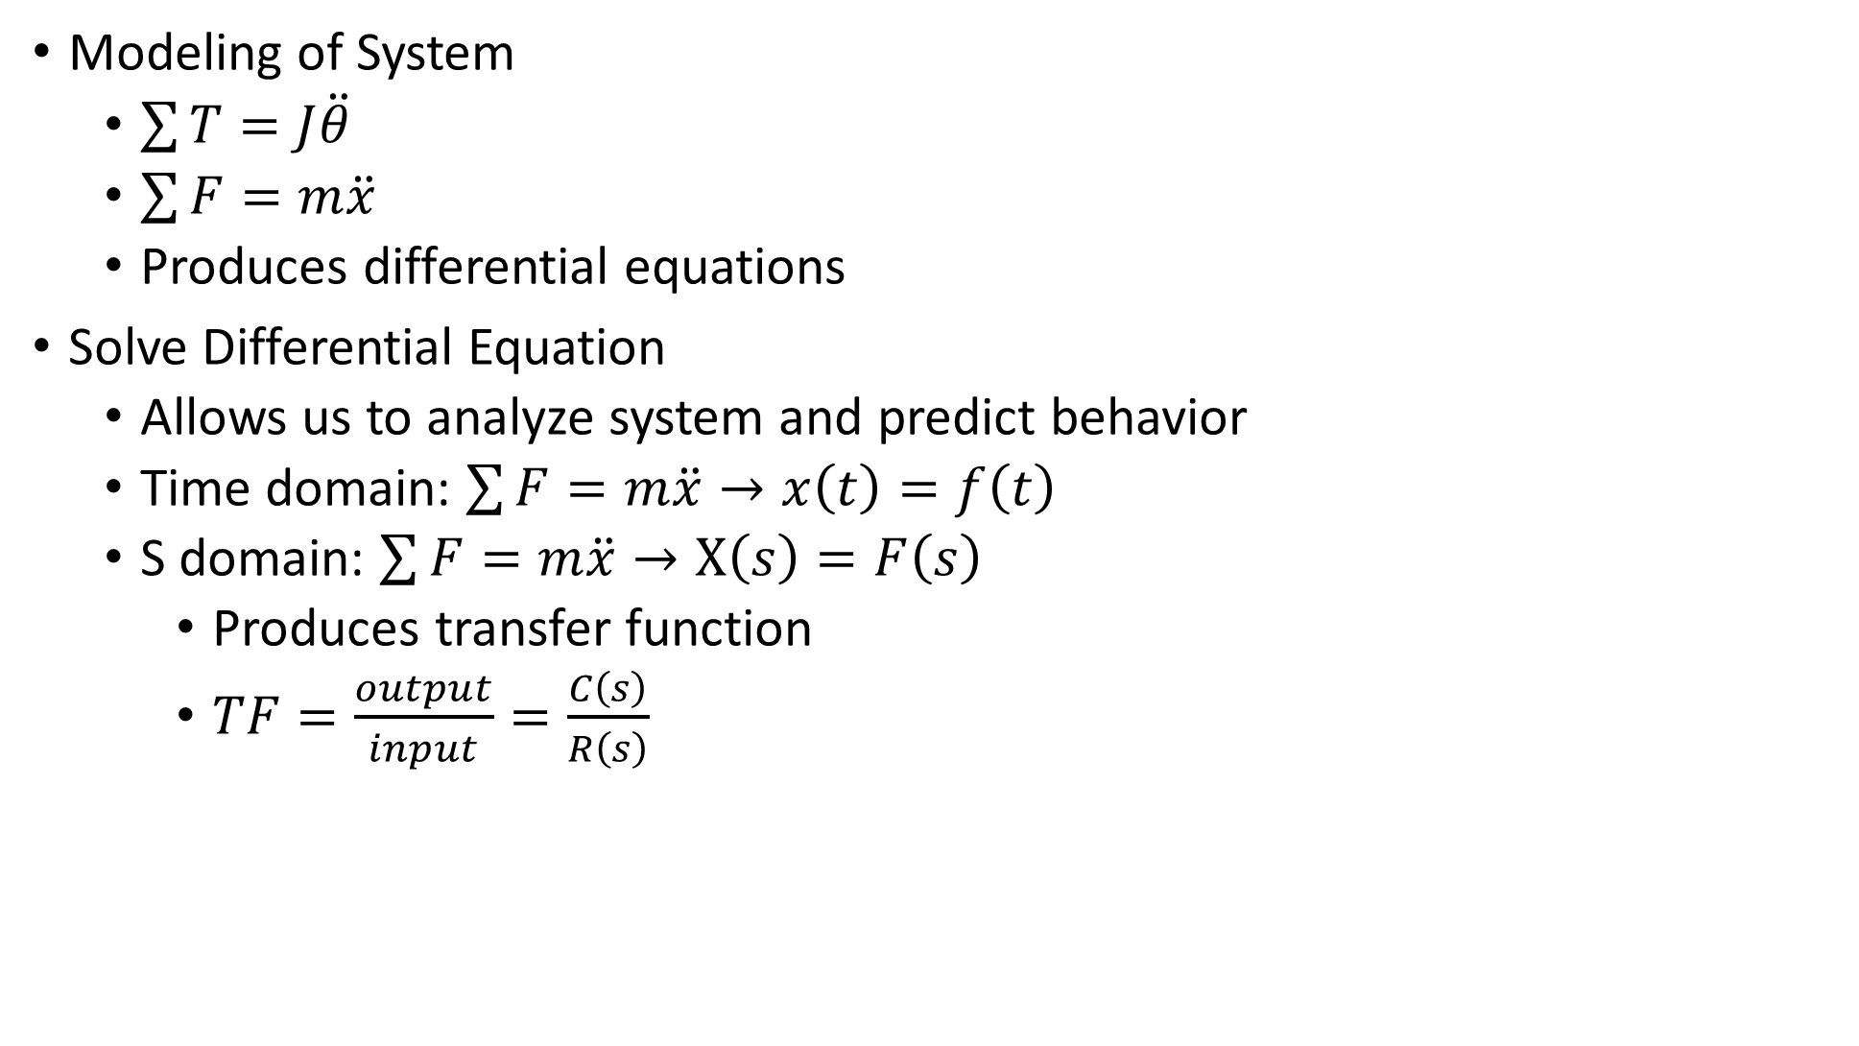
Modeling of System
$\sum{T=J\ddot{θ}}$
$\sum{F=m\ddot{x}}$
Produces differential equations
Solve Differential Equation
Allows us to analyze system and predict behavior
Time domain: $\sum{F=m\ddot{x}}→x\left(t\right)=f\left(t\right)$
S domain: $\sum{F=m\ddot{x}}→X\left(s\right)=F\left(s\right)$
Produces transfer function
$TF=\frac{output}{input}=\frac{C\left(s\right)}{R\left(s\right)}$

Slide 2
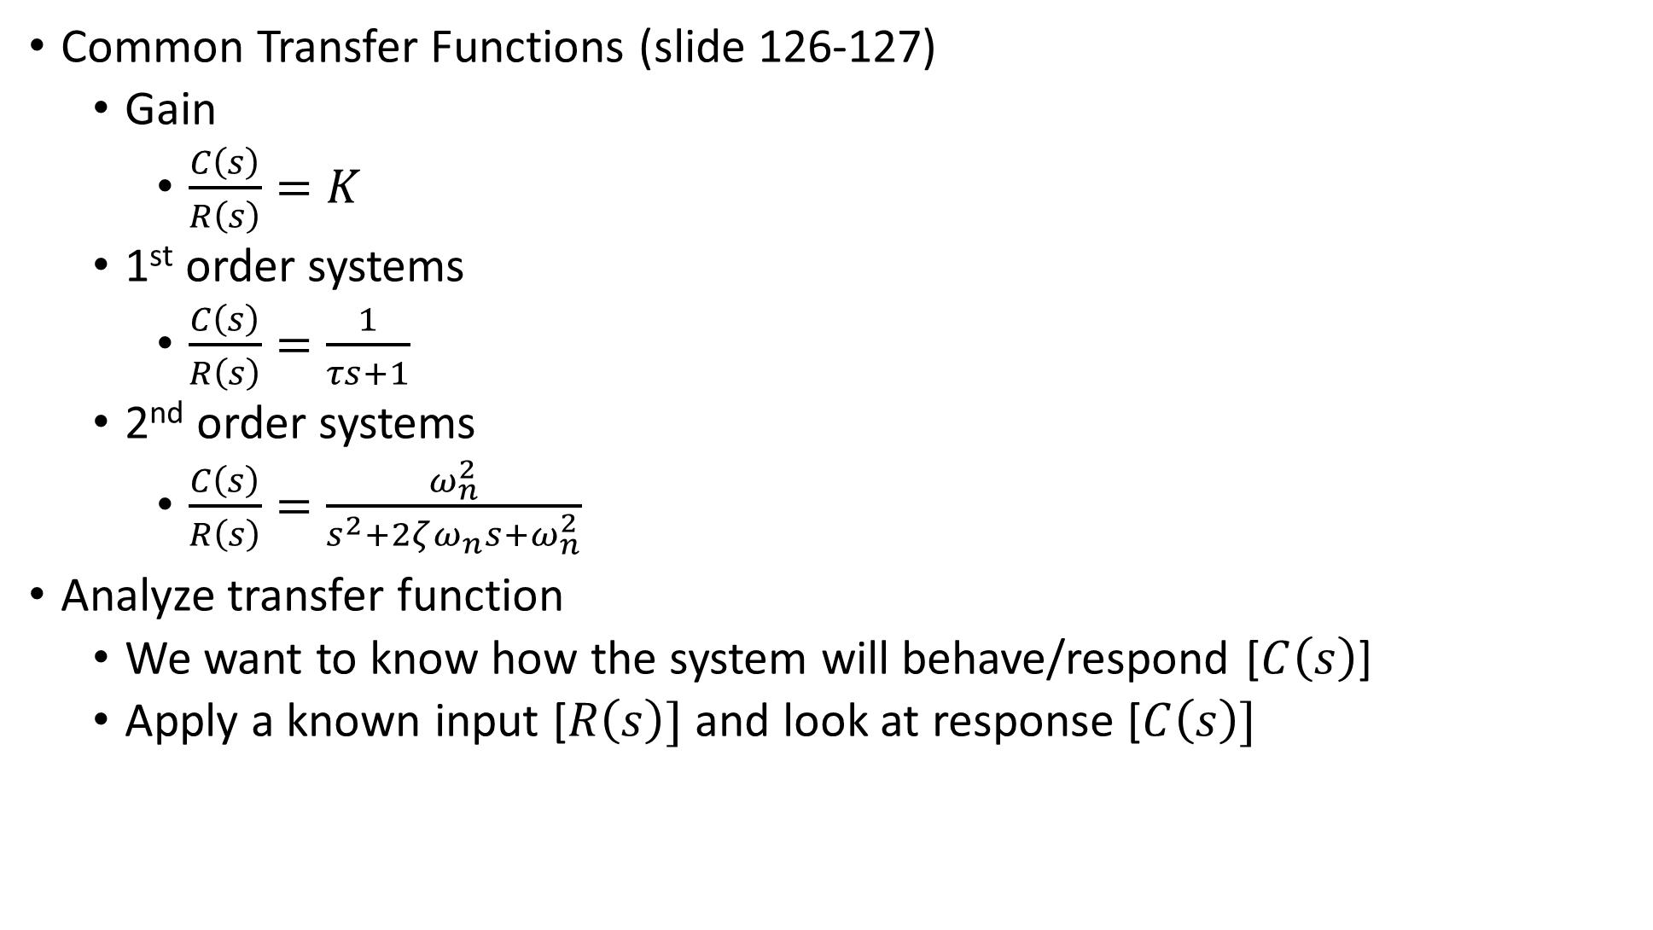
Common Transfer Functions (slide 126-127)
Gain
$\frac{C\left(s\right)}{R\left(s\right)}=K$
1st order systems
$\frac{C\left(s\right)}{R\left(s\right)}=\frac{1}{τs+1}$
2nd order systems
$\frac{C\left(s\right)}{R\left(s\right)}=\frac{ω_{n}^{2}}{s^{2}+2ζω_{n}s+ω_{n}^{2}}$
Analyze transfer function
We want to know how the system will behave/respond [$C\left(s\right)$]
Apply a known input [$R\left(s\right)]$ and look at response [$C\left(s\right)]$

Slide 3
Known Inputs: Step Input
1st order step response (slide 96)

Slide 4
Known Inputs: Step Input
2nd order step response (slide 103)

Slide 5
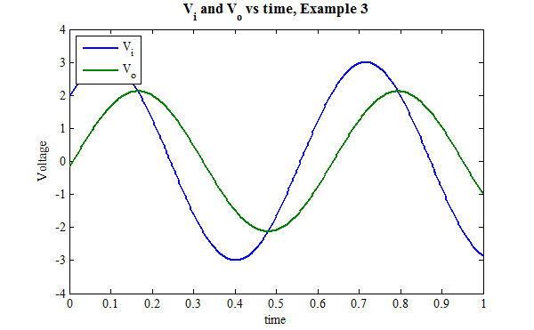

Known Inputs: Sine Wave Input
Apply sine wave as input [$R\left(s\right)$]
Wait for transients to decay
Measure magnitude and phase offset of the output [$C\left(s\right)$]

